Slide 1
Natural language understanding AT SCALE WITH SPARK NLP
Claudiu Branzan Alex Thomas David Talby

Slide 2
Natural language understanding at scale with spaCy & Spark NLP
Please setup your laptop for the tutorial:
1. Install Docker: https://docs.docker.com/engine/installation/
2. Pull the image: docker pull alnith/strata:v1
3. Run the image: docker run -it --rm -p 8888:8888 alnith/strata:v1

Slide 3
contents
prologue: LANGUAGE UNDERSTANDING use cases
Introducing SPARK NLP
NLP & ML pipelines
Named entity recognition
Spell checking & sentiment analysis
OCR
nlp for healthcare

Slide 4
The first rule of nlP is
We all speak many languages.

Slide 5

EMERGENCY ROOM LANGUAGE
Triage Notes
states started last night, upper abd, took alka seltzer approx 0500, no relief. nausea no vomiting
Since yeatreday 10/10 "constant Tylenol 1 hr ago. +nausea. diaphoretic. Mid abd radiates to back
Generalized abd radiating to lower x 3 days accompanied by dark stools. Now with bloody stool this am. Denies dizzy, sob, fatigue. Visiting from Japan on business.”
Features
Type of Pain Intensity of Pain Body part of region | Symptoms Onset of symptoms Attempted home remedy
Notes:
There is not one “language” – every vertical and communication channel has its own jargon that includes vocabulary, grammar, assumptions and semantics.
For example – in these ED triage notes, none of the sentences is in valid English, and the words “patient” and “pain” do not appear.

Slide 6
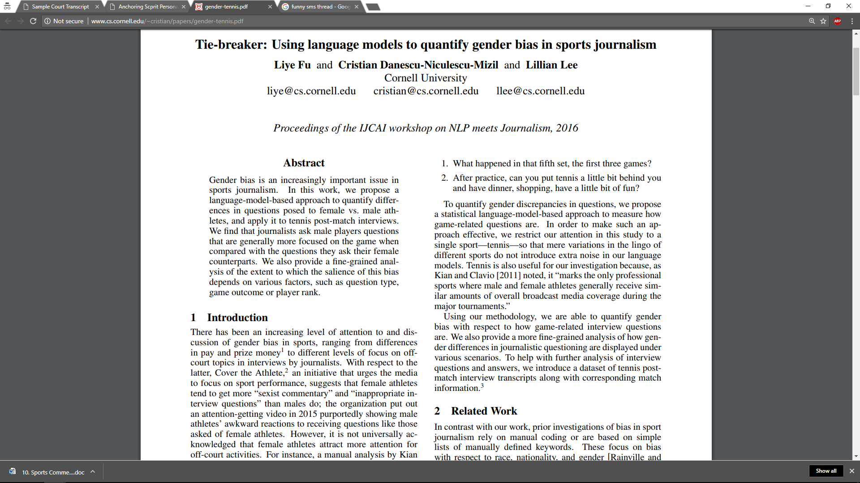
ACADEMIC LANGUAGE
Features
Summarize Main Result Theory or Experiment? Benchmark Used | Double Blind? Sample Size? All Results Published?
Title: Keyword Heavy, common word plays
Authors, affiliations & contact details
Abstract: Best Summary of Work & Results
Introduction, related work, experiment, …
Professional language, correct grammar
Notes:
There is not one “language” – every vertical and communication channel has its own jargon that includes vocabulary, grammar, assumptions and semantics.
For example – in these ED triage notes, none of the sentences is in valid English, and the words “patient” and “pain” do not appear.

Slide 7
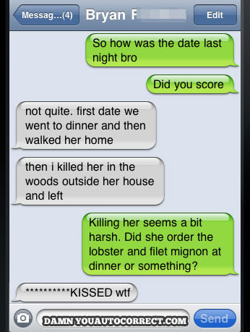
SMS LANGUAGE
Features
Who did What? When and Where? How do they feel about it?
Meaning split across many snippets
Most Snippets aren’t grammatically correct
Slang, profanity & inside jokes
Emojis for sentiment analysis
Auto-Correct Issues
Also a challenge with OCR & ASR
Notes:
There is not one “language” – every vertical and communication channel has its own jargon that includes vocabulary, grammar, assumptions and semantics.
For example – in these ED triage notes, none of the sentences is in valid English, and the words “patient” and “pain” do not appear.

Slide 8
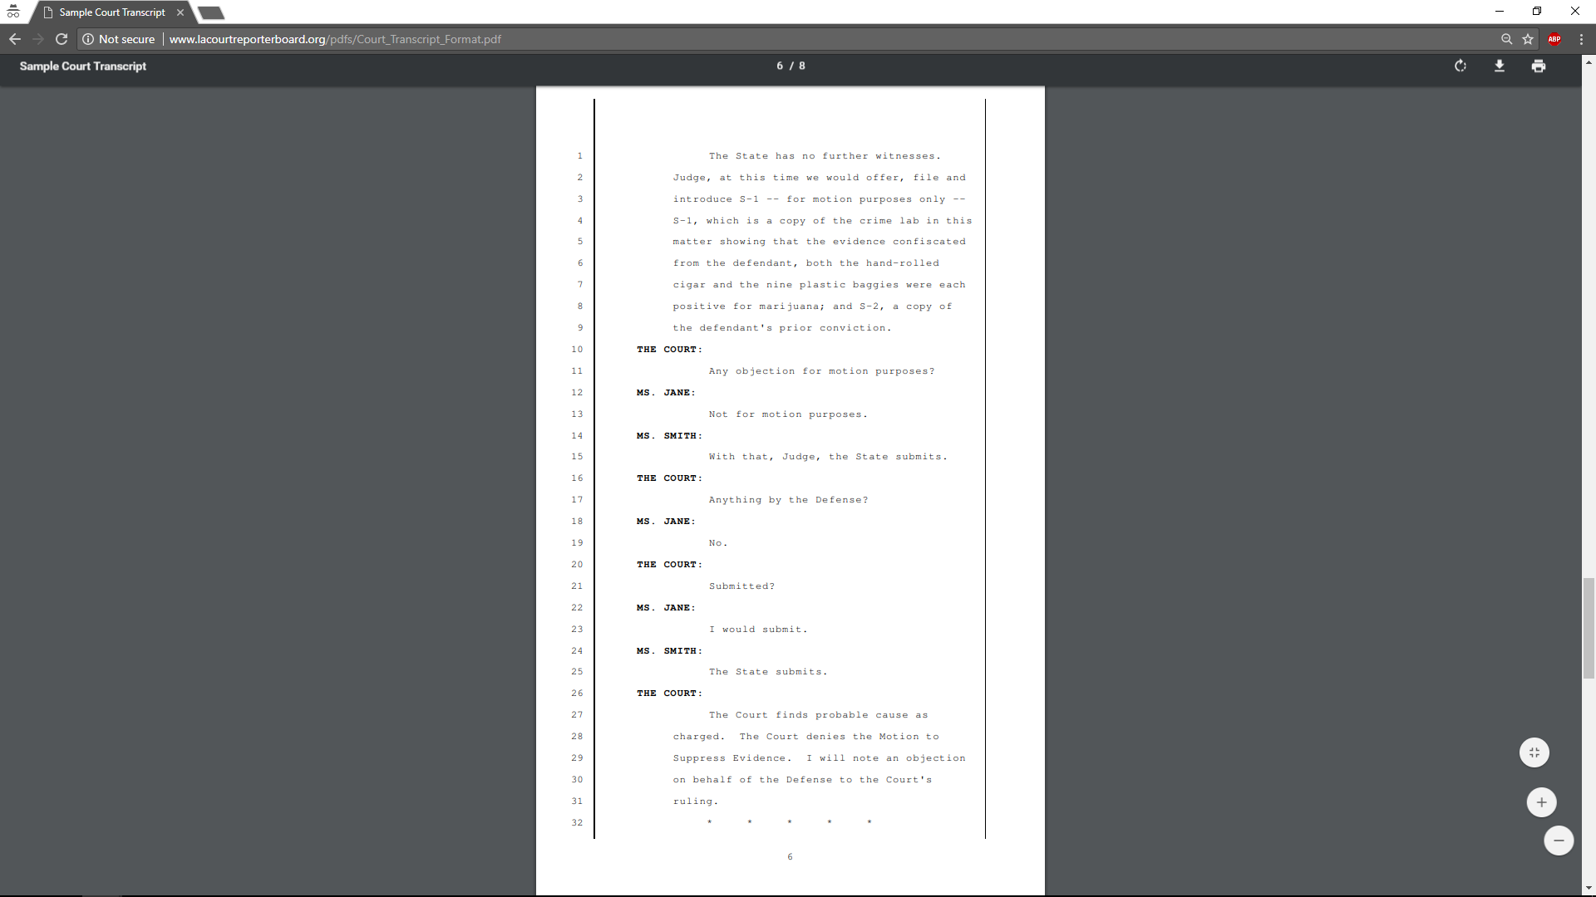
LEGAL TRANSCRIPTIONS LANGUAGE
Features
Kind of hearing Kind of motion Who filed it | Evidence presented Witnesses presented Decision
Verbatim conversation
Procedural step-by-step process
Jargon is specific to kind of procedure
Dashes indicate pauses or talkovers
Notes:
There is not one “language” – every vertical and communication channel has its own jargon that includes vocabulary, grammar, assumptions and semantics.
For example – in these ED triage notes, none of the sentences is in valid English, and the words “patient” and “pain” do not appear.

Slide 9
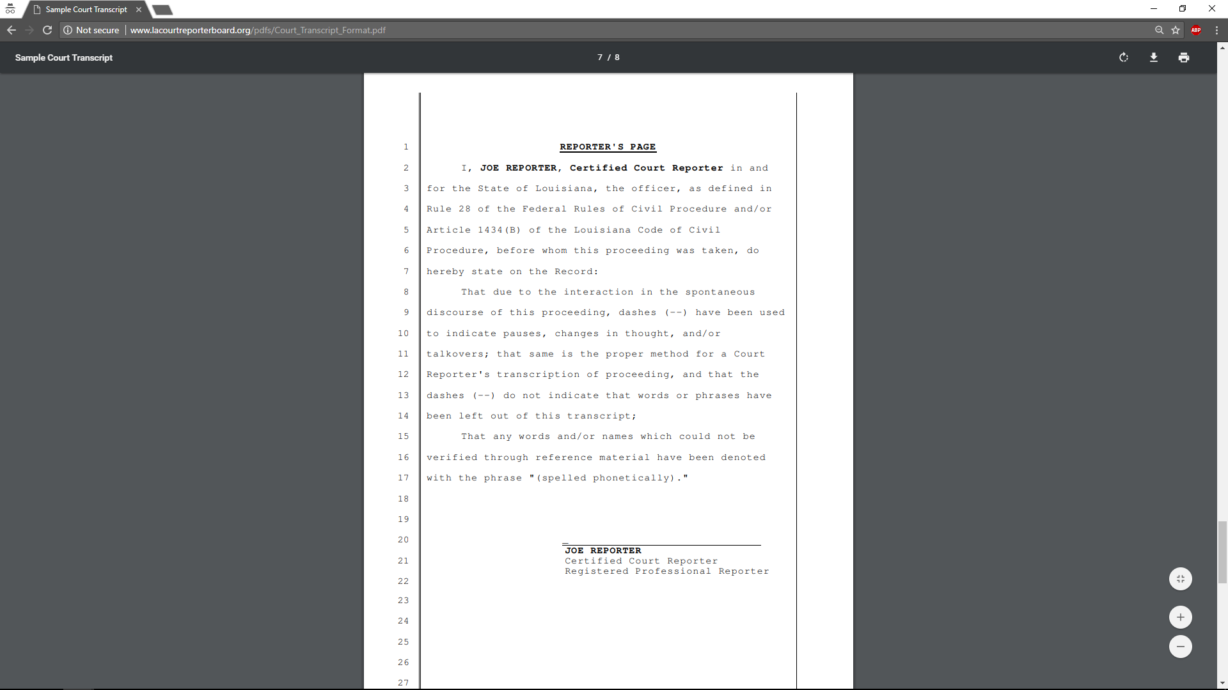
LEGAL LANGUAGE
Plus a lot of boilerplate text
This also applies to financial documents See: SEC Filings Tutorial by the National Center for Business Journalism
Notes:
There is not one “language” – every vertical and communication channel has its own jargon that includes vocabulary, grammar, assumptions and semantics.
For example – in these ED triage notes, none of the sentences is in valid English, and the words “patient” and “pain” do not appear.

Slide 10
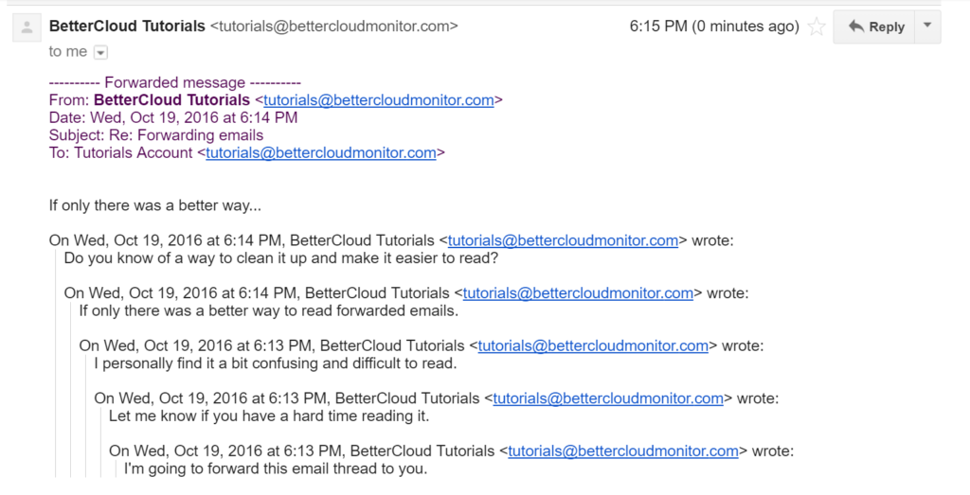
EMAIL LANGUAGE
Features
Schedule Meeting Assign a Task Approve or Deny a Request
Structured from, to, date, subject fields
Reply & Forward text in emails
Conversation: Timeline is important
Grammar of written language (not spoken)
Spam, promotions and calls to action
Notes:
There is not one “language” – every vertical and communication channel has its own jargon that includes vocabulary, grammar, assumptions and semantics.
For example – in these ED triage notes, none of the sentences is in valid English, and the words “patient” and “pain” do not appear.

Slide 11
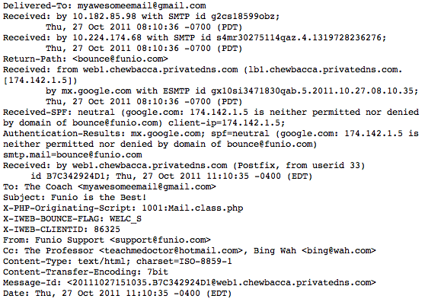
EMAIL LANGUAGE
That’s the string you actually get as input
Notes:
There is not one “language” – every vertical and communication channel has its own jargon that includes vocabulary, grammar, assumptions and semantics.
For example – in these ED triage notes, none of the sentences is in valid English, and the words “patient” and “pain” do not appear.

Slide 12
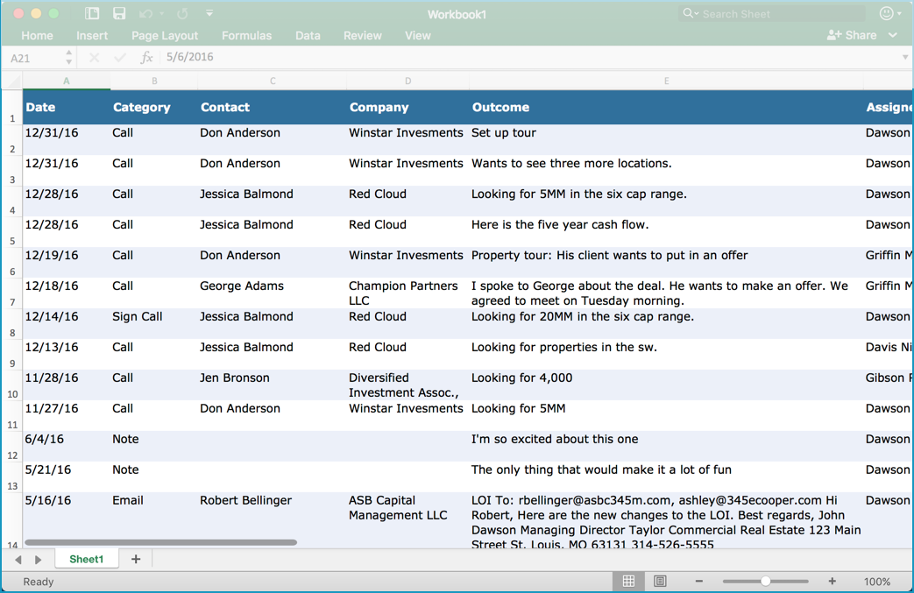
SALES (CRM) LANGUAGE
Features
Budget Authority Need Timeframe
Likelihood of a sale? Time to a sale? Need executive intervention?
Notes:
There is not one “language” – every vertical and communication channel has its own jargon that includes vocabulary, grammar, assumptions and semantics.
For example – in these ED triage notes, none of the sentences is in valid English, and the words “patient” and “pain” do not appear.

Slide 13
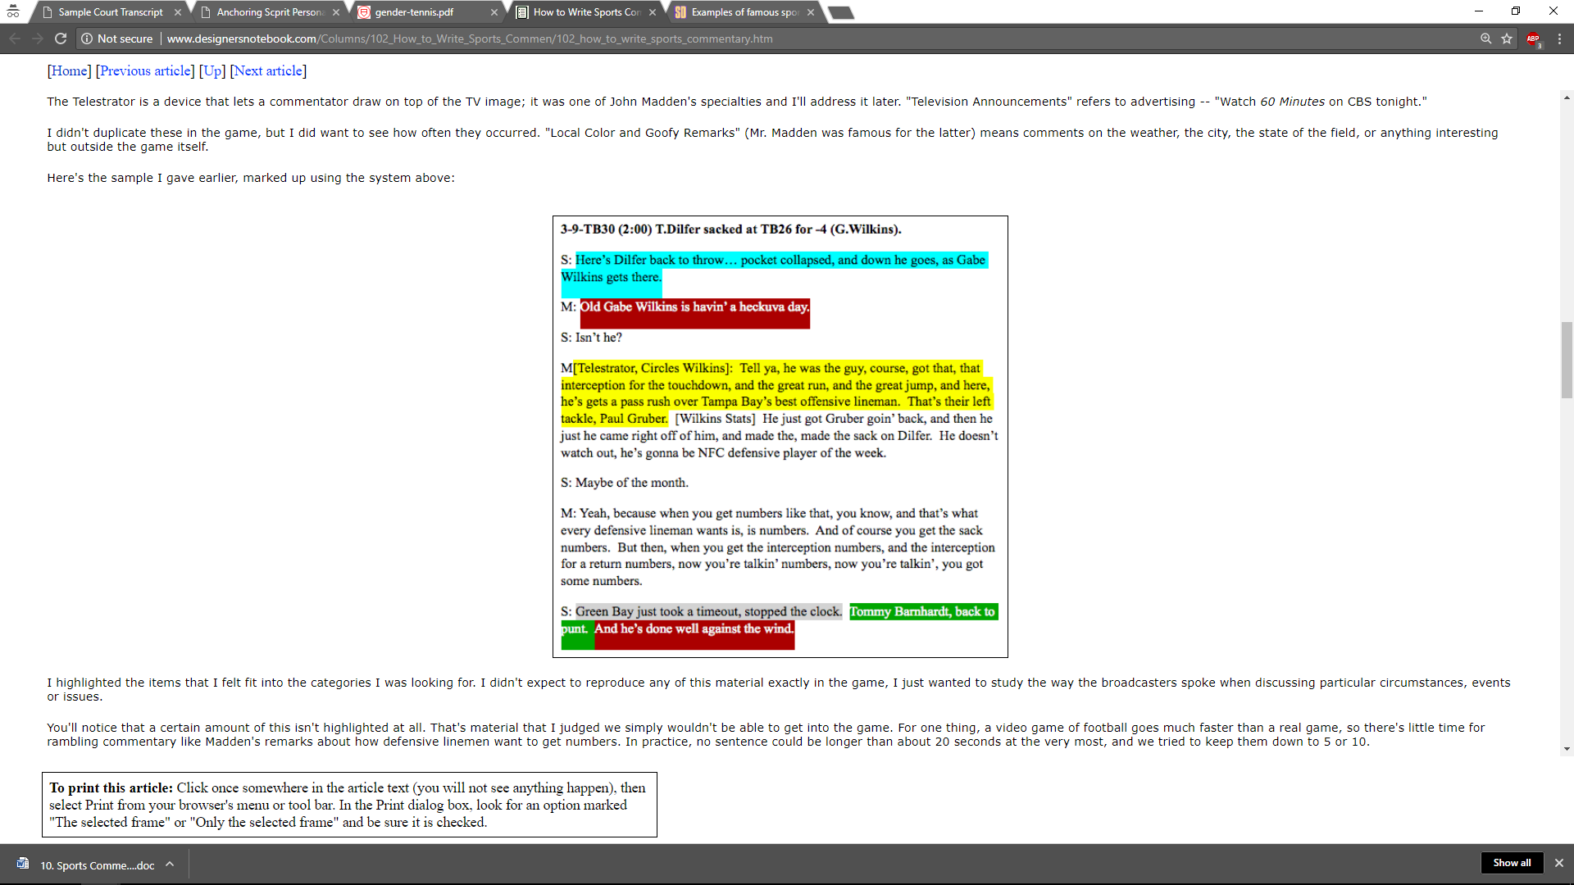
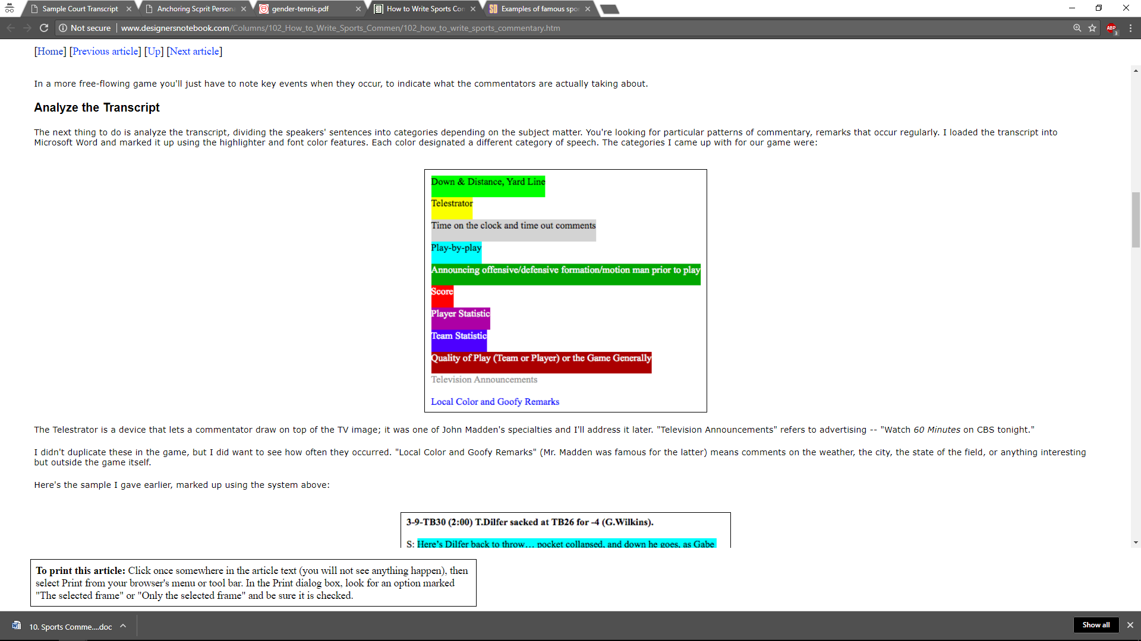
SPORTS (NFL) LANGUAGE
Notes:
There is not one “language” – every vertical and communication channel has its own jargon that includes vocabulary, grammar, assumptions and semantics.
For example – in these ED triage notes, none of the sentences is in valid English, and the words “patient” and “pain” do not appear.

Slide 14
Different Vocabulary
Tokenizer Normalizer
Lemmatizer Fact Extraction
Part of Speech Tagger Spell Checker
Coreference Resolution Dependency Parser
Sentence Splitting Negation Detection
Different Grammar
Different Context
Named Entity Recognition Sentiment Analysis
Intent Classification Summarization
Word Embeddings Emotion Detection
Different Meaning
Question Answering Relevance Ranking
Best Next Action Translation
Different Language Models

Slide 15
NLP libraries
By Ecosystem:
Python: NLTK, spaCy, gensim
JVM: OpenNLP, CoreNLP, Spark NLP, UIMA, GATE, Mallet
Others: tm for R, SAS, Watson, Matlab, …
By Design:
Raw functionality: NLTK, OpenNLP
Annotation libraries: Spark NLP, spaCy, UIMA, GATE

Slide 16
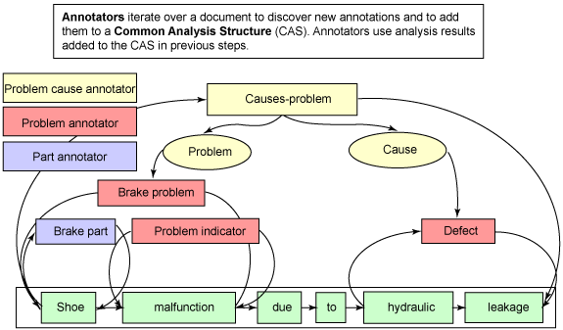
Annotation frameworks
SENTENCE DETECTION
TOKENIZER
LEMMATIZER
STOPWORD REMOVAL
NAMED ENTITY EXTRACTION
PART OF SPEECH TAGGING
SPELL CHECKER
SENTIMENT ANALYSIS
ASSERTION STATUS DETECTION

Slide 17
Introducing spark nlp
Industrial Grade NLP for the Spark ecosystem
Design Goals
Performance & Scale
Frictionless Reuse
Enterprise Grade
Built on top of the Spark ML API’s
Apache 2.0 licensed
Active development & support: 23 releases in 2018

Slide 18
Native spark extension

Slide 19
Frictionless reuse
pipeline = pyspark.ml.Pipeline(stages=[ document_assembler, tokenizer, stemmer, normalizer, stopword_remover, tf, idf, lda])
topic_model = pipeline.fit(df)
Spark NLP annotators
Spark ML featurizers
Spark ML LDA implementation
Single execution plan for the given data frame

Slide 20
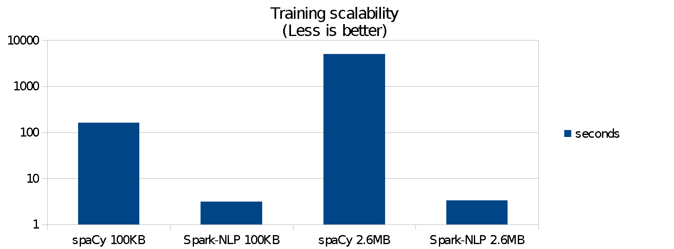
Benchmark: training
Run on a desktop PC, Linux Mint with 16GB RAM, local SSD drives, & Intel core i5-6600K processor running 4 cores at 3.5GHz
Data has been taken from the National American Corpus (http://www.anc.org), utilizing the MASC 3.0.2 written corpora from the newspaper section.
Pipeline has Sentence Boundary, Tokenization & Part of Speech
Spark-NLP was 38 times faster to train on 100kb of data
Spark-NLP was 80 times faster to train on 2.6mb of data

Slide 21
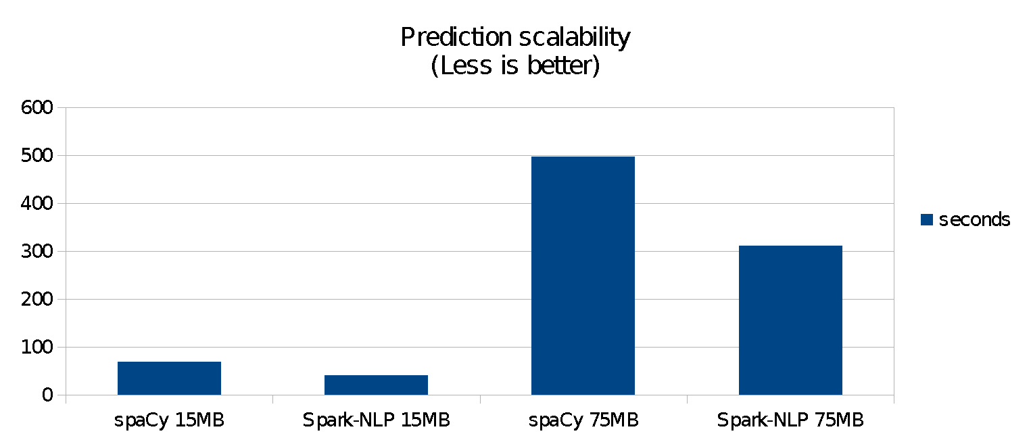
Benchmark: PREDICTION
spaCy was faster on a 140kb dataset (both libraries finished in under a second)
Spark-NLP was 1.4 times faster on a 15mb dataset (about 40 vs. 70 seconds)
Spark-NLP was 1.6 times faster on a 75mb dataset (about 5 vs. 9 minutes)
Both libraries were configured to leverage all CPU cores

Slide 22
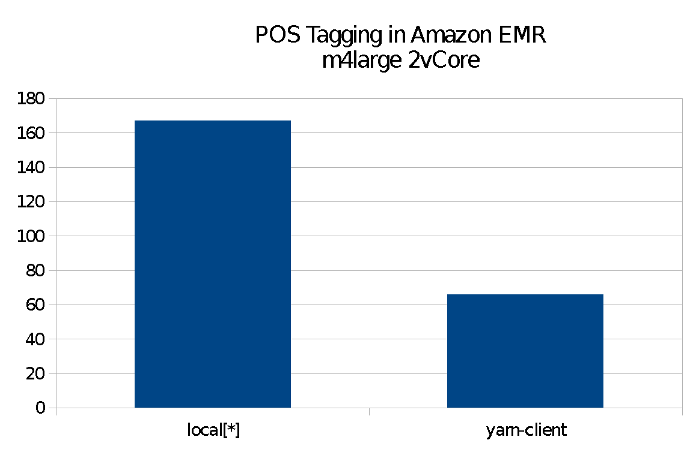
Benchmark: SCALING
Spark-NLP against itself
2.5x speedup with a 4-node cluster
Zero code changes
Spark scales as Spark does: 1 to 3 orders of magnitude faster depending on cluster setup
Not compares to spaCy, since it cannot leverage a cluster

Slide 23
Notebook:
Introducing spaRk nlp

Slide 24
Notebook:
Nlp & ml pipelines

Slide 25
ML & NLP: Common misconceptions
I can keep my NLP and ML pipelines separate
So, can I just store the NLP output, then iterate with ML?
No. Feature engineering is part of your ML pipeline
An NLP library needs its own model training code
So, should it implement its own ML algorithms?
No. The world doesn’t need another KNN / W2V / CRF
I don’t need to train, because libraries come with models
So, can I just reuse the models that came with my library?
No, in most cases. NLP is medium- & domain-specific

Slide 26
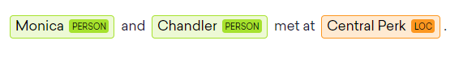
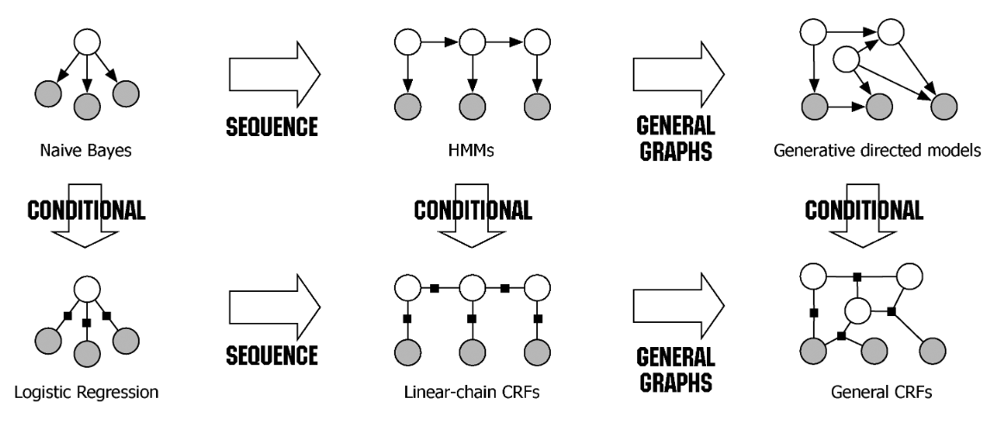
Named entity recognition
From Sutton & McCallum’s An Introduction to Conditional Random Fields.
Notes:
Challenges in NER: Going beyond dictionaries and lists. For examples, “Chandler” is obviously not the city of Chandler, AZ and “Central Perk” is obviously a place even if you’ve never heard of it (since it the location of a meeting).
There can be many kinds of entities that a given problem will need to extract: companies, people, genes, diseases, financial terms, etc.

Slide 27
FROM CRF TO deep learning (and back)
Starting Point: “Classic” machine learning approach
CoNLL-2003 shared task dataset
CRF++ Implementation
Feature engineering:
the token itself
Its Bigram & trigram
Their prefix & suffix
Its part of speech
Its chunk type
Does it start with a capital?
Is it uppercase?
Is it a digit?
Surrounding context words
81.15%
F-score
From Yves Peirsman’s Named Entity Recognition and the Road to Deep Learning
Notes:
Challenges in NER: Going beyond dictionaries and lists. For examples, “Chandler” is obviously not the city of Chandler, AZ and “Central Perk” is obviously a place even if you’ve never heard of it (since it the location of a meeting).
There can be many kinds of entities that a given problem will need to extract: companies, people, genes, diseases, financial terms, etc.

Slide 28
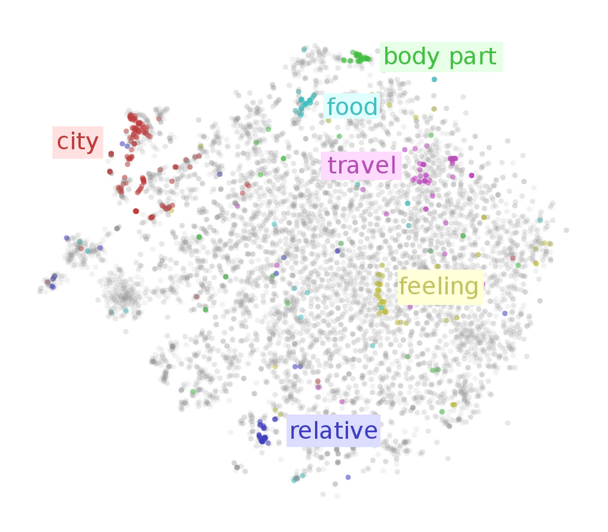
CRF + WORD embeddings
Replacing curated dictionaries with embeddings to model semantic similarity
84.9%
F-score
From Yves Peirsman’s Named Entity Recognition and the Road to Deep Learning
Notes:
Challenges in NER: Going beyond dictionaries and lists. For examples, “Chandler” is obviously not the city of Chandler, AZ and “Central Perk” is obviously a place even if you’ve never heard of it (since it the location of a meeting).
There can be many kinds of entities that a given problem will need to extract: companies, people, genes, diseases, financial terms, etc.

Slide 29
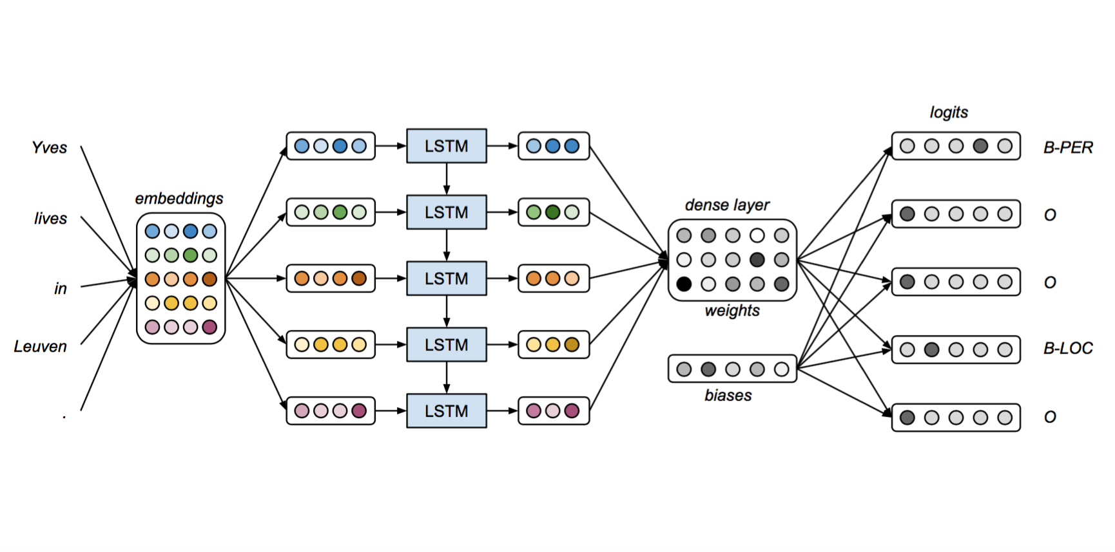
FORGET CRF. Let’s use an lstm network
An LSTM is a type of RNN, well suited for sequential data with long-term dependencies
64.9%
LSTM F-score
76.1%
biLSTM F-score
From Yves Peirsman’s Named Entity Recognition and the Road to Deep Learning
Notes:
Challenges in NER: Going beyond dictionaries and lists. For examples, “Chandler” is obviously not the city of Chandler, AZ and “Central Perk” is obviously a place even if you’ve never heard of it (since it the location of a meeting).
There can be many kinds of entities that a given problem will need to extract: companies, people, genes, diseases, financial terms, etc.

Slide 30
Transfer learning: use pretrained embeddings
Reuse the embeddings trained on Wikipedia, instead of on CoNNL which only has 200,000 words
85.9%
F-score
From Yves Peirsman’s Named Entity Recognition and the Road to Deep Learning
Notes:
Challenges in NER: Going beyond dictionaries and lists. For examples, “Chandler” is obviously not the city of Chandler, AZ and “Central Perk” is obviously a place even if you’ve never heard of it (since it the location of a meeting).
There can be many kinds of entities that a given problem will need to extract: companies, people, genes, diseases, financial terms, etc.

Slide 31
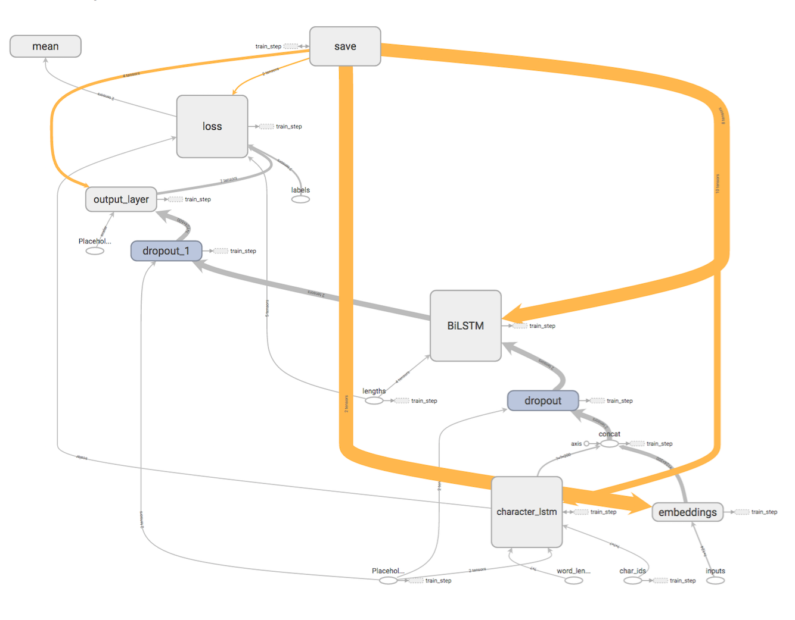
Add character based model: bi-lstm or cnn
In addition to token based models, add a character-based biLSTM or CNN to learn and model word prefixes and suffixes
89.3%
F-score
From Yves Peirsman’s Named Entity Recognition and the Road to Deep Learning
Notes:
Challenges in NER: Going beyond dictionaries and lists. For examples, “Chandler” is obviously not the city of Chandler, AZ and “Central Perk” is obviously a place even if you’ve never heard of it (since it the location of a meeting).
There can be many kinds of entities that a given problem will need to extract: companies, people, genes, diseases, financial terms, etc.

Slide 32
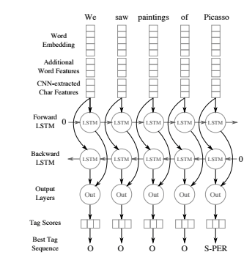
Deep learning for ner
F-Score | Dataset | Task
85.81% | 2010 i2b2 | Medical concept extraction
92.29% | 2012 i2b2 | Clinical event detection
94.37% | 2014 i2b2 | De-identification
“Entity Recognition from Clinical Texts via Recurrent Neural Network”.
Liu et al., BMC Medical Informatics & Decision Making, July 2017.

Slide 33
Notebooks:
Ner with crf
Ner with deep learning

Slide 34
Spell checking & correction
Automated Spell Checker
Trainable – for domain specific use cases
Norvig Approach:
Retrieves tokens and auto-corrects based on a given dictionary
Symmetric Delete:
Uses distance metrics to find possible words.

Slide 35
Sentiment analysis
Vivekn Sentiment Analyzer:
Train on a set of positive and negative examples
Rule based Sentiment Analyzer:
Define a set of tokens for positive, negative, increment, decrement and reverse multipliers

Slide 36
Notebooks:
Spell checking &
Sentiment analysis

Slide 37
Object character recognition (OCR)
Image pre-processing
Layout detection
Distributed OCR
Sentence breaking
OCR spell correction
+

Slide 38
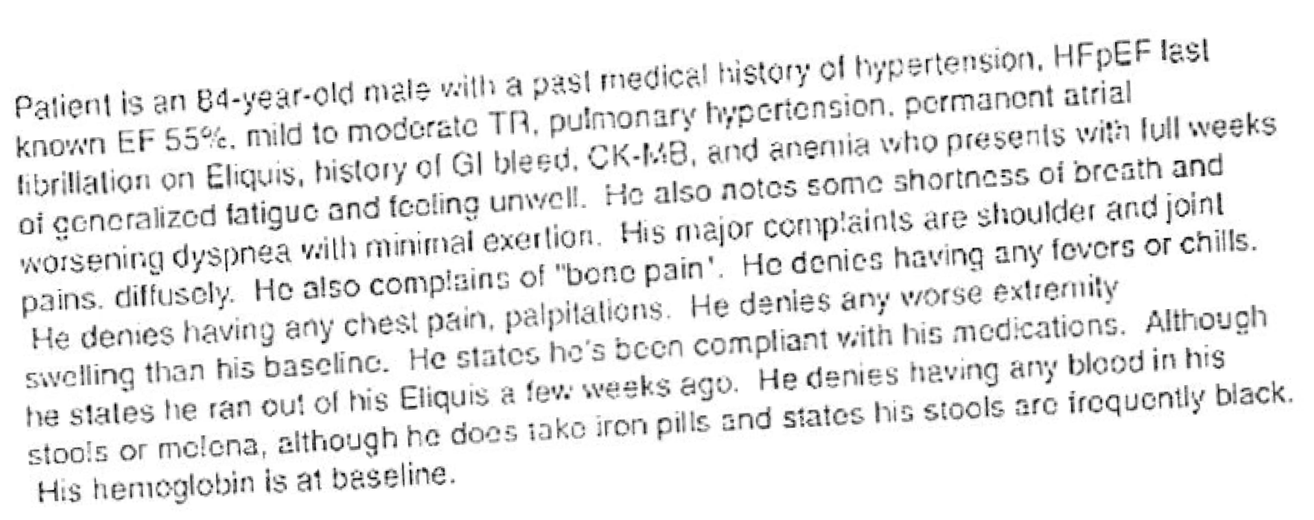
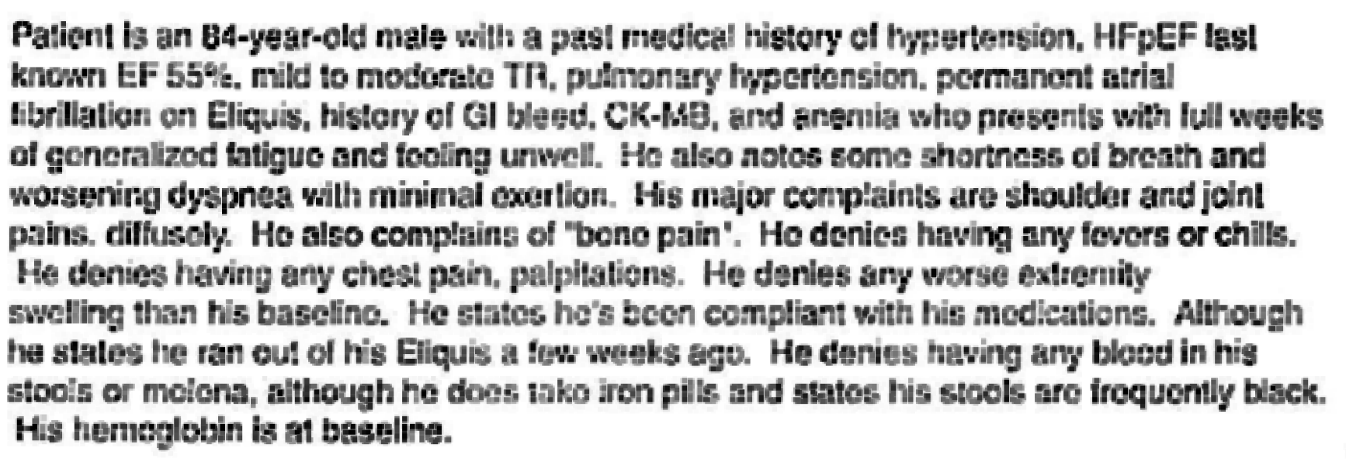
OCR: IMAGE Pre-processing

Slide 39
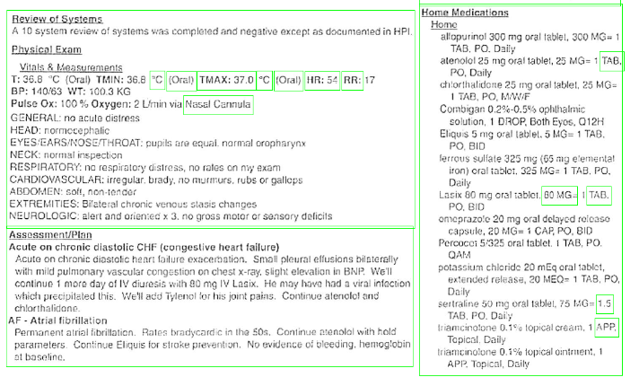
OCR: Layout

Slide 40
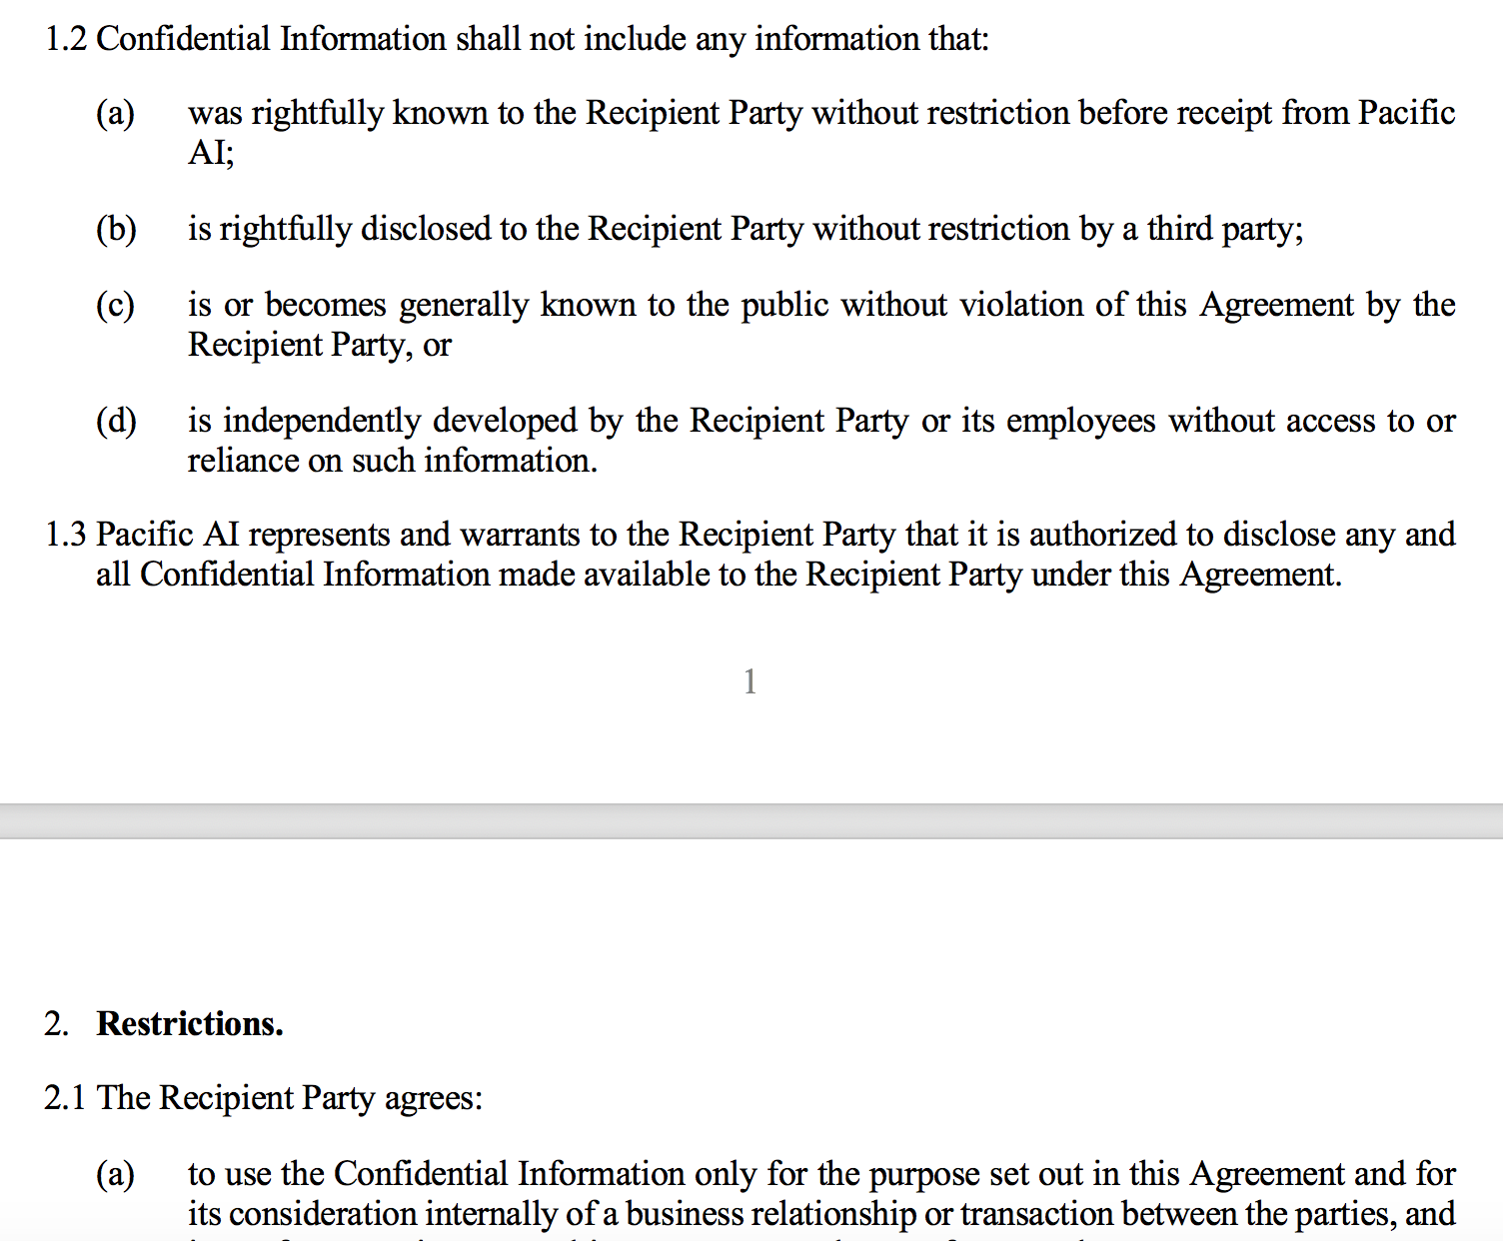
OCR SPECIFIC SENTENCE DETECTION & SPELL CHECKING
Sentence detection handles:
Page breaks
Paragraph breaks
Headers & footers
Lists
Enumerations
OCR-specific spell checker
e <-> c
n <-> m
l <> 1
O <> 0

Slide 41
Radiology
Mental Health
Diagnostic
Safety Events
Pre-Auth
Inpatient
Key Opinion Leaders
Meta Analysis
Research
Clinical Coding
Anti-Fraud
Adverse Events
Recruit for Trials
Financial
Drug Development
NLP in Healthcare
Deep Learning
NLP
Efficiency
Accuracy

Slide 42
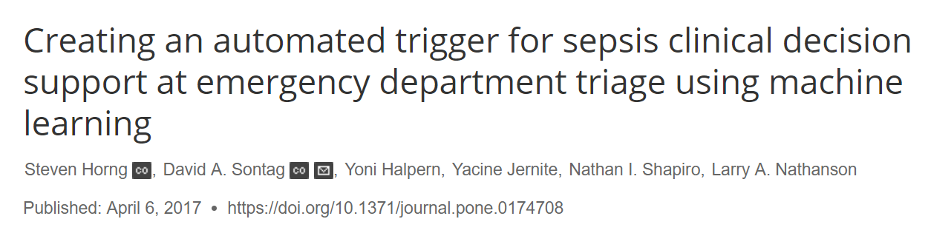
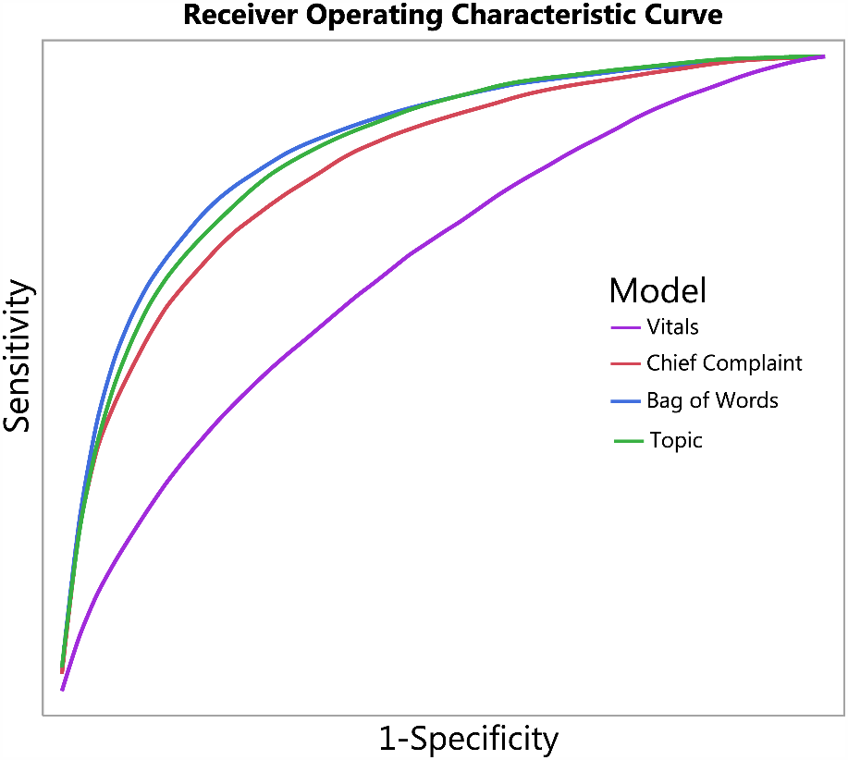
Risk prediction Case Study: Detecting Sepsis
“Compared to previous work that only used structured data such as vital signs and demographic information, utilizing free text drastically improves the discriminatory ability (increase in AUC from 0.67 to 0.86) of identifying infection.”

Slide 43

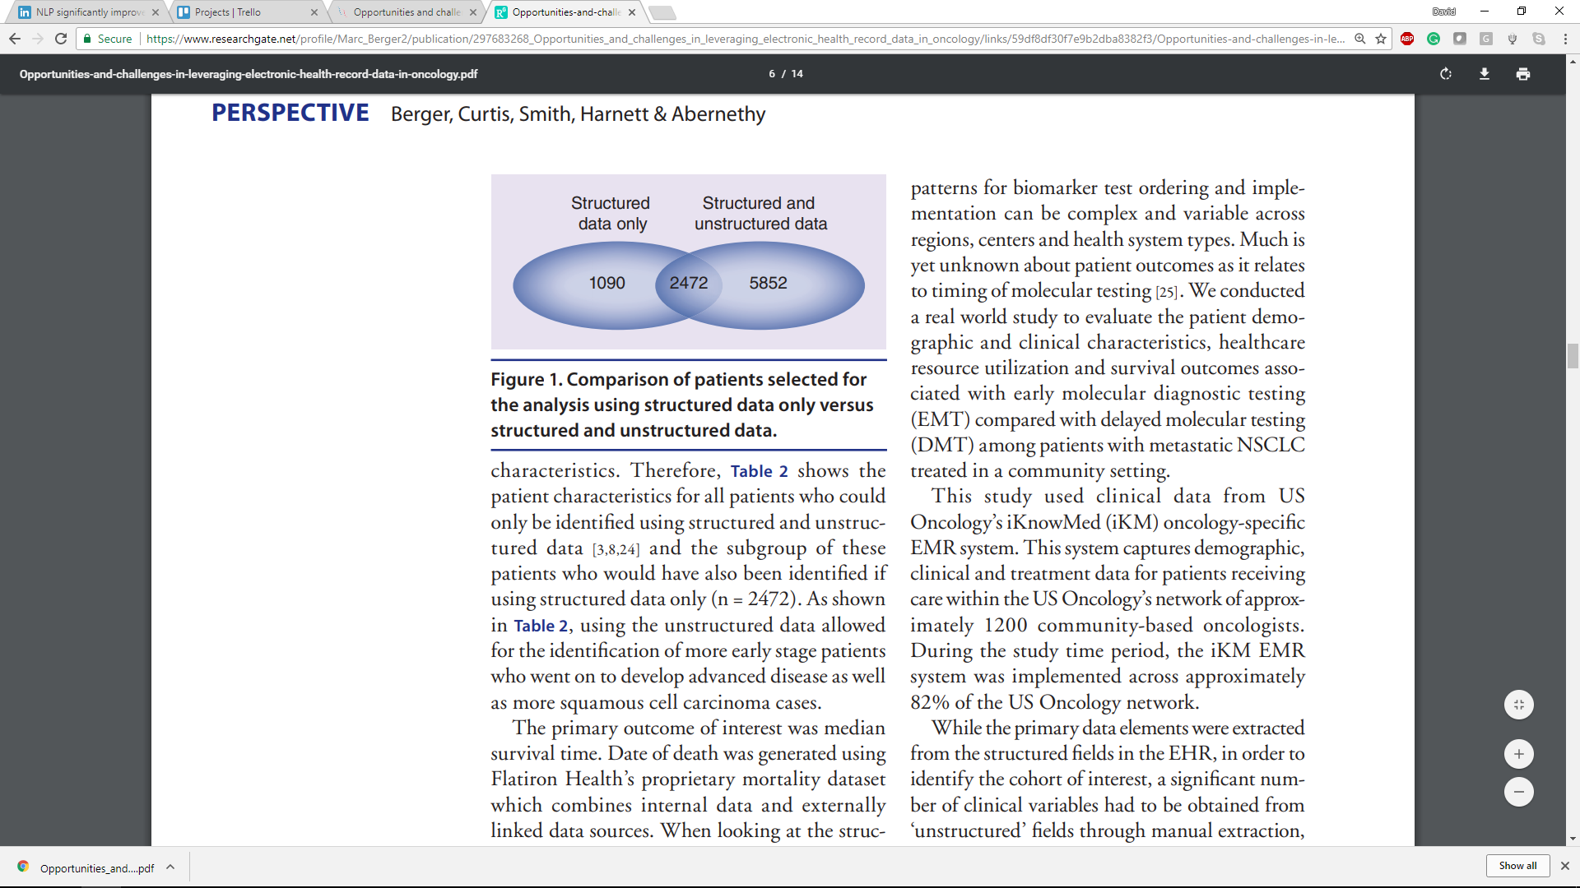
Cohort selection Case Study: Oncology
“Using the combination of structured and unstructured data, 8324 patients were identified as having advanced NSCLC.
Of these patients, only 2472 were also in the cohort generated using structured data only.
Further, 1090 patients would be included in the structured data only cohort who should have been excluded based on additional data.”

Slide 44
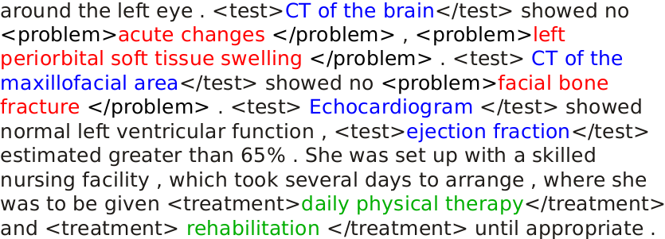
Named entity recognition

Slide 45
DE-IDENTIFICATION

Slide 46
Deep learning for ner
F-Score | Dataset | Task
85.81% | 2010 i2b2 | Medical concept extraction
92.29% | 2012 i2b2 | Clinical event detection
94.37% | 2014 i2b2 | De-identification
“Entity Recognition from Clinical Texts via Recurrent Neural Network”.
Liu et al., BMC Medical Informatics & Decision Making, July 2017.

Slide 47
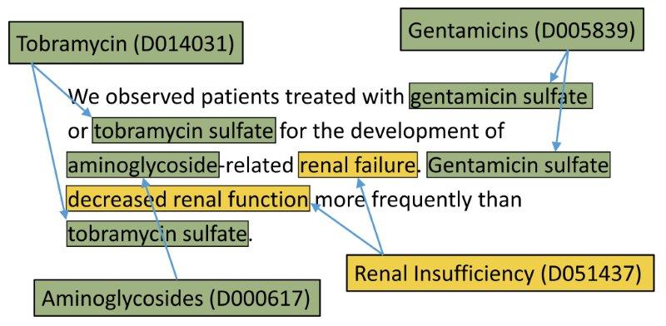
Entity RESOLUTION

Slide 48
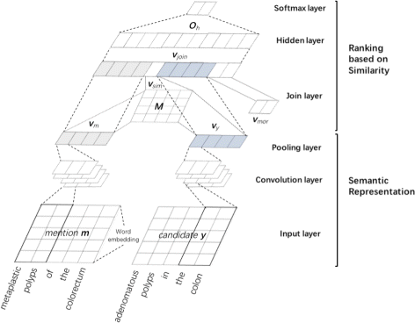
Deep learning for Entity RESOLUTION
F-Score | Dataset | Task
90.30% | ShARe / CLEF | Disease & problem norm.
92.29% | NCBI | Disease norm. in literature
“CNN-based ranking for biomedical entity normalization”.
Li et al., BMC Bioinformatics, October 2017.

Slide 49
ASSERTION STATUS DETECTION
Prescribing sick days due to diagnosis of influenza. | Positive
Jane complains about flu-like symptoms. | Speculative
Jane’s RIDT came back clean. | Negative
Jane is at risk for flu if she’s not vaccinated. | Conditional
Jane’s older brother had the flu last month. | Family history
Jane had a severe case of flu last year. | Patient history

Slide 50
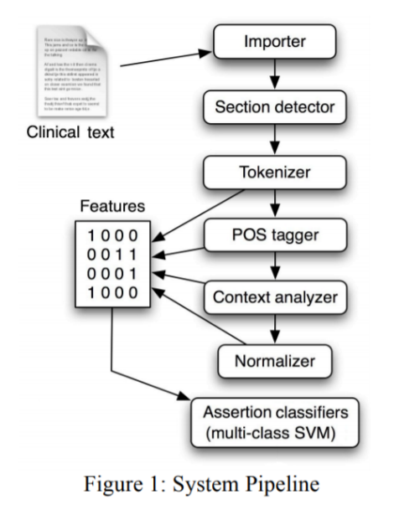
Machine learning for assertion status detection
 | Dataset | Metric
94.17% | 4th i2b2/VA | Mirco-averaged F₁
79.76% |  | Marco-averaged F₁
“Neural Networks For Negation Scope Detection“
Fancellu et al., In Proceedings of the 54th Annual Meeting of the Association for Computational Linguistics, 2016.

Slide 51
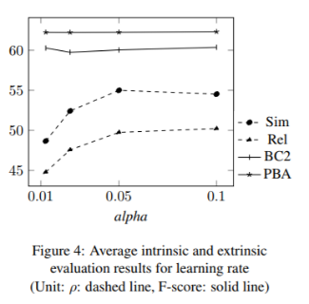
Biomedical word embeddings
Intrinsic measures (similarity between concepts)
Extrinsic measures (improving NER)
Hyperparameter optimization
Sub-sampling
Minimum-count
Learning rate
Vector dimension
Context window size
Available under an open license here
“How to Train Good Word Embeddings for Biomedical NLP”.
Chiu et al., In Proceedings of BioNLP’16, August 2016.

Slide 52

Healthcare Extensions
com.johnsnowlabs.nlp.clinical.*
Healthcare specific NLP annotators for Spark in Scala, Java or Python:
Entity Recognition
Value Extraction
Word Embeddings
Assertion Status
Sentiment Analysis
Spell Checking, …
data.johnsnowlabs.com/health
1,800+ Expert curated, clean, linked, enriched & always up to date data:
Terminology
Providers
Demographics
Clinical Guidelines
Genes
Measures, …

Slide 53
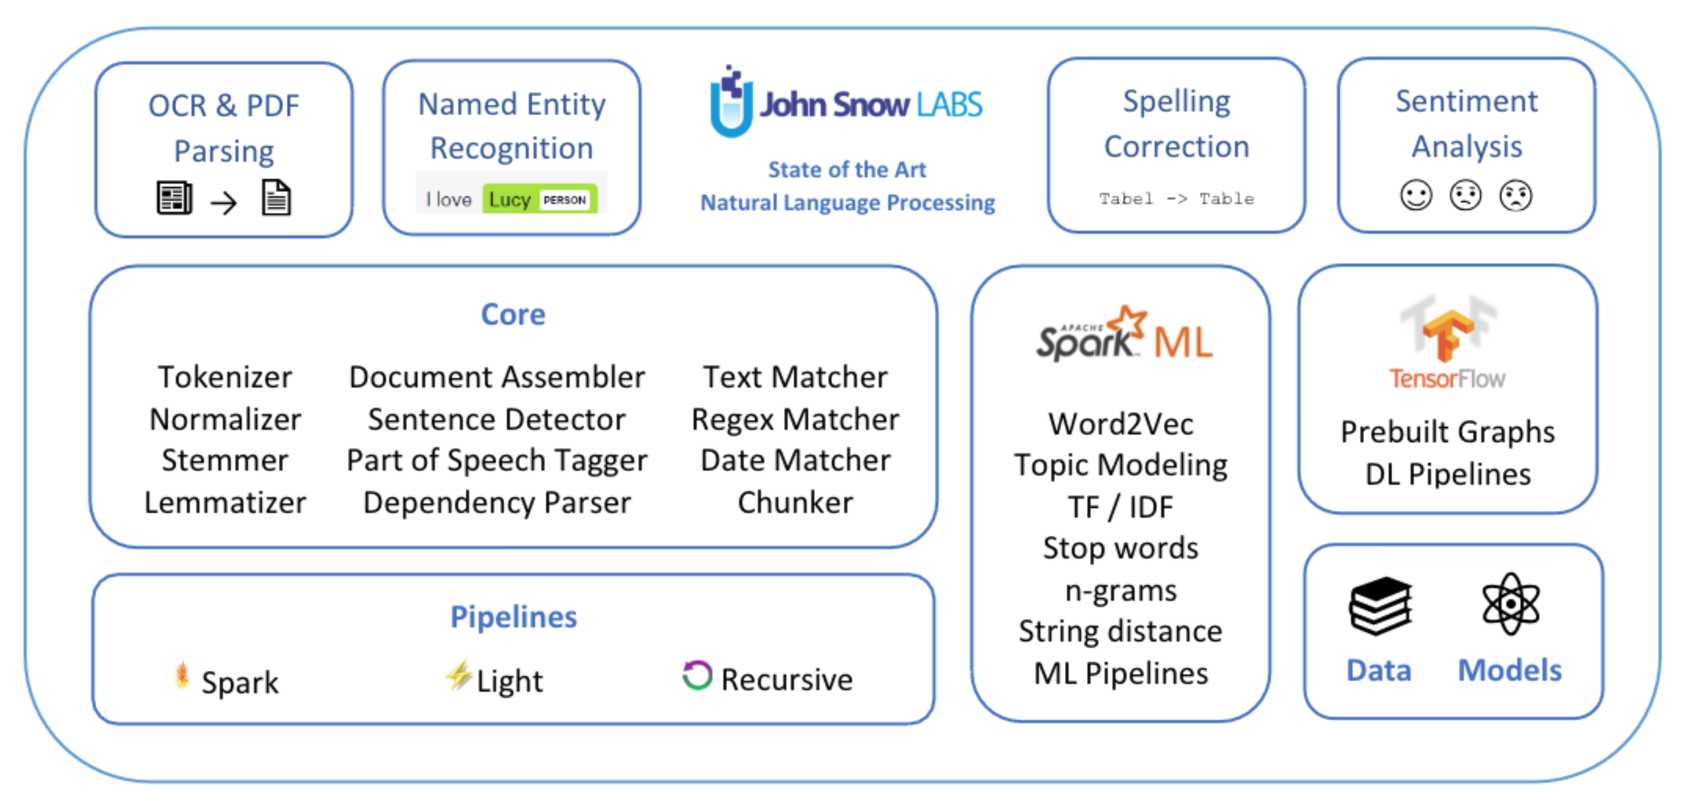
Summary: spark nlp in 2018

Slide 54
THANK you!
Homepage: https://nlp.johnsnowlabs.com Getting Started, Docs, Examples, Videos, Blogs, Slack Community | GitHub: https://github.com/ johnsnowlabs/spark-nlp Releases, Issues & Feature Requests
Claudiu Branzan Alex Thomas David Talby

